Slide 1

The Software Development Life Cycle Models
Pertemuan 1
Dr. Dedi Trisnawarman

Slide 2
1. Systems Development Life Cycle
The systems development life cycle (SDLC) is the process of determining how an information system (IS) can support business needs, designing the system, building it, and delivering it to users.
The key person in the SDLC is the systems analyst, who analyzes the business situation, identifies the opportunities for improvements, and designs an IS to implement the improvements.

Slide 3
Systems Development Life Cycle
The SDLC is composed of four fundamental phases:
Planning
Analysis
Design
Implementation
Each of the phases is composed of steps, which rely on techniques that produce deliverables (specific documents that explain various elements of the system).

Slide 4
Planning
This phase is the fundamental process of understanding why an information system should be built, and determining how the project team will go about building it.

Slide 5
The planning phase has two steps:
During project initiation, the system’s business value to the organization is identified (How will it lower costs or increase revenues?).
During project management, the project manager creates a work plan, staffs the project, and puts techniques in place to help the project team control and direct the project through the entire SDLC.

Slide 6
Analysis
The analysis phase answers the questions of who will use the system, what the system will do, and where and when it will be used.
During this phase the project team investigates any current system(s), identifies improvement opportunities, and develops a concept for the new system.

Slide 7
The analysis phase has three steps:
Analysis strategy: This is developed to guide the projects team’s efforts. This includes a study of the current system and its problems, and envisioning ways to design a new system.
Requirements gathering: The analysis of this information leads to the development of a concept for a new system. This concept is used to build a set of analysis models.
System proposal: The proposal is presented to the project sponsor and other key individuals who decide whether the project should continue to move forward.

Slide 8
Design
The design phase decides how the system will operate, in terms of the hardware, software, and network infrastructure; the user interface, forms, and reports that will be used; and the specific programs, databases, and files that will be needed.

Slide 9
The design phase has four steps:
Design Strategy: This clarifies whether the system will be developed by the company or outside the company.
Architecture Design: This describes the hardware, software, and network infrastructure that will be used.
Database and File Specifications: These documents define what and where the data will be stored.
Program Design: Defines what programs need to be written and what they will do.

Slide 10
Implementation
During the implementation phase, the system is either developed or purchased (in the case of packaged software) and installed.
This phase is usually the longest and most expensive part of the process.

Slide 11
The implementation phase has three steps:
System Construction: The system is built and tested to make sure it performs as designed.
Installation: The old system is turned off and the new one is turned on.
Support Plan: Includes a post-implementation review as well as a systematic way for identifying changes needed for the system.

Slide 12
Project Identification and Initiation
A project is identified when someone in the organization identifies a business need to build a system.
A need may surface when an organization identifies unique and competitive ways of using IT.
To leverage the capabilities of emerging technologies such as cloud computing, RFID, Web 2.0

Slide 13
Business Process Management (BPM)
Nowadays many new IS projects grow out of BPM.
BPM is a methodology used by organizations to continuously improve end-to-end business processes.

Slide 14
BPM Process
Defining and mapping the steps in a business process.
Creating ways to improve on the steps in the process that add value
Finding ways to eliminate or consolidate steps in the process that do not add value
Creating and adjusting electronic workflows to match the improved process maps.

Slide 15
(cont’d)
Business process automation (BPA) – technology components are used to complement or substitute manual process.
Business process improvement (BPI) – creating new, re-designed processes to improve the workflows, and/or utilizing new technologies enabling new process structures.
Business process reengineering (BPR) – changing the fundamental way in which the organization operate.

Slide 16
Project Sponsor
The project sponsor is a person (or group) who has an interest in the system’s success
The project sponsor will work throughout the SDLC to make sure that the project is moving in the right direction from the perspective of the business.
The project sponsor serves as the primary point of contact for the project team.
The size or scope of the project determines by the kind of sponsor that is involved.

Slide 17
(cont’d)
The project sponsor has the insights needed to determine the business value that will be gained from the system.
Tangible value can be quantified and measured easily (reduction in operating costs).
An intangible value results from an intuitive belief that the system provides important, but hard-to-measure benefits to the organization.

Slide 18
System Request
The document that describes the business reasons for building a system and the value that system is expected to provide.
The project sponsor usually completes this form as part of a formal system selection process within the organization.

Slide 19
(cont’d)
The business requirements of the project refer to the business capabilities that the system will need to have.
The business value describes the benefits that the organization should expect from the system.
Special issues are included on the document as a catchall category for other information that should be considered in assessing the project.

Slide 20
(cont’d)
The completed system request is submitted to the approval committee for consideration.
The committee reviews the system request and makes an initial determination of whether to investigate the proposed project or not.
If so, the next step is to conduct a feasibility analysis.

Slide 21
Feasibility Analysis
Feasibility analysis guides the organization in determining whether to proceed with a project.
Feasibility analysis also identifies the important risks associated with the project that must be managed if the project is approved.

Slide 22
(cont’d)
As with the system request, each organization has its own process and format for the feasibility analysis, but most include techniques to assess three areas:
Technical feasibility
Economic feasibility
Organizational feasibility
The results of evaluating these three feasibility factors are combined into a feasibility study deliverable that is submitted to the approval committee at the end of project initiation.

Slide 23
Technical Feasibility
Technical feasibility is the extent to which the system can be successfully designed, developed, and installed by the IT group.
It is, in essence, a technical risk analysis that strives to answer the question: “Can we build it?”

Slide 24
(cont’d)
Risks can endanger the successful completion of a project. The following aspects should be considered:
Users’ and analysts’ should be familiar with the application.
Familiarity with the technology
Project size
Compatibility of the new system with the technology that already exists

Slide 25
Economic Feasibility
Economic feasibility analysis is also called a cost-benefit analysis, that identifies the costs and benefits associated with the system.
This attempts to answer the question: “Should we build the system?”

Slide 26
Cash Flow Analysis and Measures
IT projects involve an initial investment that produces a steam of benefits over time, along with some on-going support costs.
Cash flows, both inflows and outflows, are estimated over some future period.

Slide 27
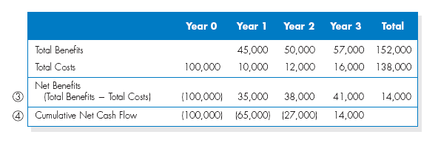
Simple Cash Flow Projection

Slide 28
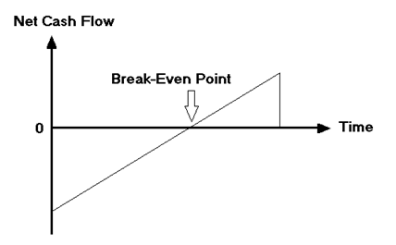
Common Methods for Evaluating a Project’s Worth
Return on Investment (ROI)
ROI=(Total Benefits – Total Costs)/Total Costs
Break-Even Point (BEP)

Slide 29
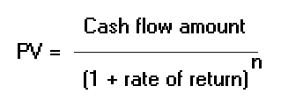
Discounted Cash Flow Technique
Discounted case flows are used to compare the present value of all cash inflows and outflows for the project in the today’s dollar terms.
Net present value (NPV): the difference between the total PV of the benefits and the total PV of the costs.

Slide 30
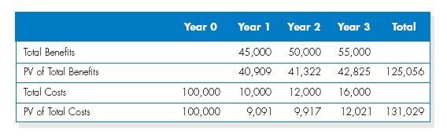
Discounted Cash Flow Projection

Slide 31
Steps to Conduct an Economic Feasibility Analysis
Identify Costs and Benefits
Assign Values to Costs and Benefits
Determine Cash Flow
Assess Project’s Economic Value
ROI
BEP
NPV

Slide 32
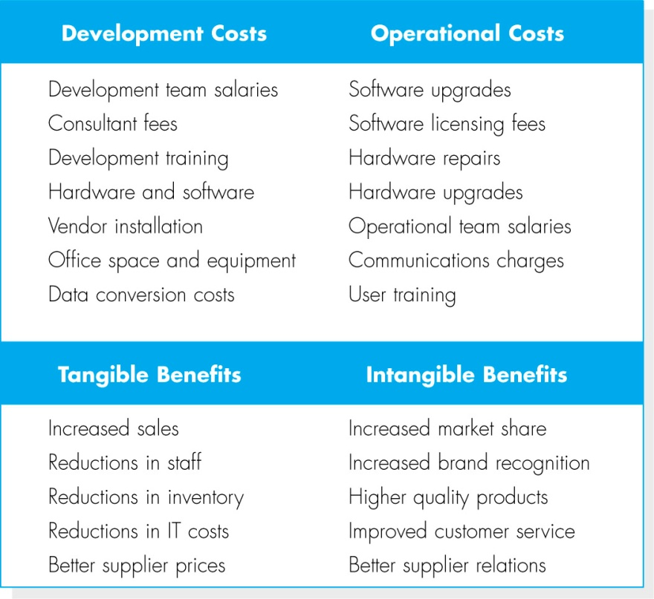
Identify Costs and Benefits
The costs and benefits and be broken down in to four categories:
Development costs
Operational costs
Tangible benefits
Intangibles

Slide 33
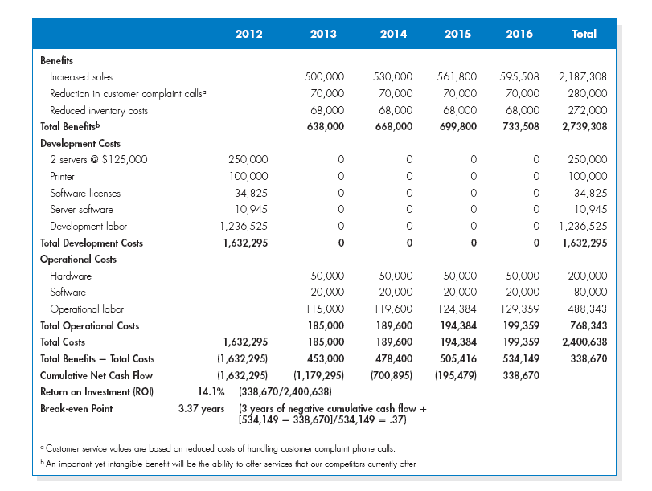
Assign Values to Costs and Benefits
Once the types of costs and benefits have been identified, the systems analysts needs to assign specific dollar values to them.

Slide 34
Determine Cash Flow
A formal cost-benefit analysis usually contains costs and benefits over a selected number or years to show cash flow over time.
- Determine ROI
- Determine BEP
- Determine NPV

Slide 35
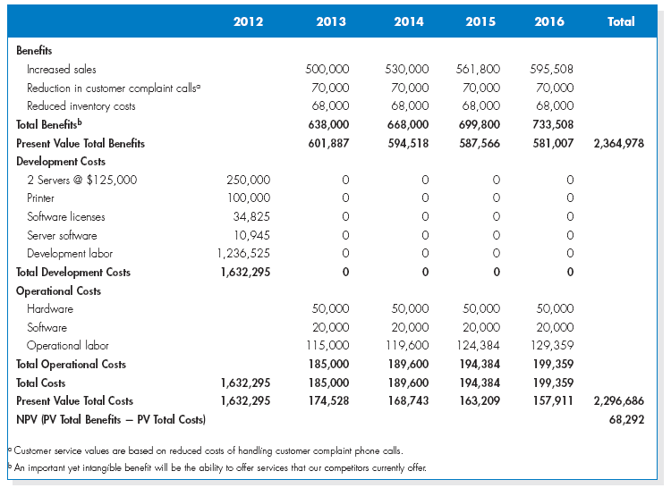
(cont’d)

Slide 36
Organizational Feasibility
Organizational feasibility of the system is how well the system ultimately will be accepted by its users and incorporated into the ongoing operations of the organization.
There are many organizational factors that can have an impact on the project, and seasoned developers know that organizational feasibility can be the most difficult feasibility dimension to assess.
In essence, an organizational feasibility analysis is to answer the question “If we build it, will they come?”

Slide 37
(cont’d)
One way to assess the organizational feasibility is to understand how well the goals of the project align with the business objectives and organizational strategies.
A second way to assess the organizational feasibility is to conduct stakeholder analysis.
A stakeholder is a person, group, or organization that can affect a new system
- Project champion
- System users
- Organizational management
- Other stakeholders

Slide 38
Advantages and disadvantages of SDLC
Benefits of abiding by a clearly defined SDLC model include:
Having a clear view of an entire project, workers involved, estimated costs and timelines.
Gives project managers a projected base cost of the project.
Goals and standards are clearly defined.
Developers can move back a step if something does not go as expected.
Disadvantages, however, can include:
Due to assumptions made at the beginning of a project, if an unexpected circumstance complicates the development of a system, then it may stockpile into more complications down the road. As an example, if newly installed hardware does not work correctly, then it may increase the time a system is in development, increasing the cost.
Some methods are not flexible.
It can be complicated to estimate the overall cost at the beginning of a project.
Testing at the end of development may slow down some development teams.

Slide 39
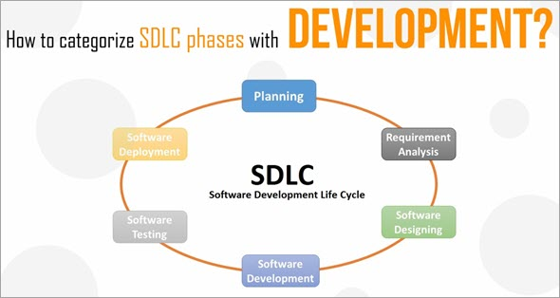
Software Development Life Cycle Models
A software life cycle model is a descriptive representation of the software development cycle. SDLC models might have a different approach but the basic phases and activity remain the same for all the models.

Slide 40
2. Waterfall model
Waterfall model is an example of a Sequential model. In this model, the software development activity is divided into different phases and each phase consists of a series of tasks and has different objectives.
Waterfall model is the pioneer of the SDLC processes. In fact, it was the first model which was widely used in the software industry. It is divided into phases and output of one phase becomes the input of the next phase. It is mandatory for a phase to be completed before the next phase starts. In short, there is no overlapping in the Waterfall model

Slide 41
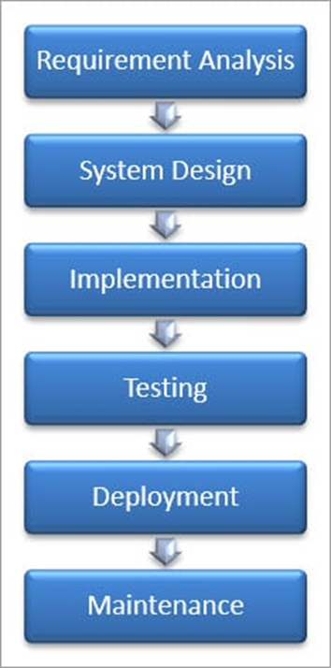
Waterfall model
First, Requirement gathering and analysis is done. Once the requirement is freeze then only the System Design can start. Herein, the SRS document created is the output for the Requirement phase and it acts as an input for the System Design.
In System Design Software architecture and Design, documents which act as an input for the next phase are created i.e. Implementation and coding.
In the Implementation phase, coding is done and the software developed is the input for the next phase i.e. testing.
In the testing phase, the developed code is tested thoroughly to detect the defects in the software. Defects are logged into the defect tracking tool and are retested once fixed. Bug logging, Retest, Regression testing goes on until the time the software is in go-live state.
In the Deployment phase, the developed code is moved into production after the sign off is given by the customer.
Any issues in the production environment are resolved by the developers which come under maintenance.

Slide 42
Waterfall model - Requirement Analysis
Phase | Activities Performed | Deliverables
Requirement Analysis | Capture all the requirements. Do brainstorming and walkthrough to understand the requirements. Do the requirements feasibility test to ensure that the requirements are testable or not. | RUD ( Requirements Understanding Document)

Slide 43
Waterfall model - System Design
S.No | Phase | Activities Performed | Deliverables
2 | System Design | As per the requirements, create the design Capture the hardware / software requirements. Document the designs | HLD ( High Level Design document) LLD (Low level design document)

Slide 44
Waterfall model - Implementation
Phase | Activities Performed | Deliverables
Implementation | As per the design create the programes / code Integrate the codes for the next phase. Unit testing of the code | Programs Unit test cases and results

Slide 45
Waterfall model - System Testing
Phase | Activities Performed | Deliverables
System Testing | Integrate the unit tested code and test it to make sure if it works as expected. Perform all the testing activities (Functional and non functional) to make sure that the system meets the requirements. In case of any anomaly, report it. Track your progress on testing through tools like traceability metrics, ALM Report your testing activities. | Test cases Test reports Defect reports Updated matrices.

Slide 46
Waterfall model - System Deployment
Phase | Activities Performed | Deliverables
System Deployment | Make sure that the environment is up Make sure that there are no sev 1 defects open. Make sure that the test exit criteria are met. Deploy the application in the respective environment. Perform a sanity check in the environment after the application is deployed to ensure the application does not break. | User Manual Environment definition / specification

Slide 47
Waterfall model - System Deployment
Phase | Activities Performed | Deliverables
System maintenance | Make sure that the application is up and running in the respective environment. Incase user encounters and defect, make sure to note and fix the issues faced. Incase any issue is fixed; the updated code is deployed in the environment. The application is always enhanced to incorporate more features, update the environment with the latest features | User Manual List of production tickets List of new features implemented.

Slide 48
Waterfall model
Advantages of the Waterfall Model:
Waterfall model is the simple model which can be easily understood and is the one in which all the phases are done step by step.
Deliverables of each phase are well defined, and this leads to no complexity and makes the project easily manageable.
Disadvantages of Waterfall model:
Waterfall model is time-consuming & cannot be used in the short duration projects as in this model a new phase cannot be started until the ongoing phase is completed.
Waterfall model cannot be used for the projects which have uncertain requirement or wherein the requirement keeps on changing as this model expects the requirement to be clear in the requirement gathering and analysis phase itself and any change in the later stages would lead to cost higher as the changes would be required in all the phases.

Slide 49
When To Use SDLC Waterfall Model?
SDLC Waterfall model is used when
Requirements are stable and not changed frequently.
An application is small.
There is no requirement which is not understood or not very clear.
The environment is stable
The tools and techniques used is stable and is not dynamic
Resources are well trained and are available.

Slide 50
V-Shaped Model
V- Model is also known as Verification and Validation Model. In this model Verification & Validation goes hand in hand i.e. development and testing goes parallel.
V model and waterfall model are the same except that the test planning and testing start at an early stage in V-Model.

Slide 51
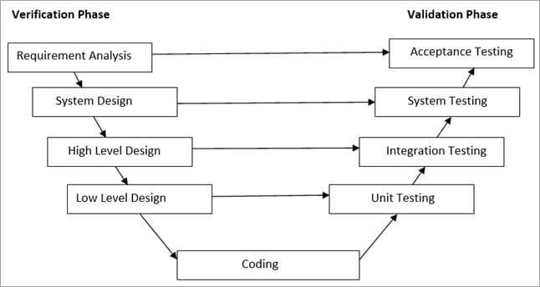
V-Shaped Model

Slide 52
V-Shaped Model-Validation Phase
Unit Testing: Unit testing is performed using the unit test cases that are designed and is done in the Low-level design phase. Unit testing is performed by the developer itself. It is performed on individual components which lead to early defect detection.
Integration Testing: Integration testing is performed using integration test cases in High-level Design phase. Integration testing is the testing that is done on integrated modules. It is performed by testers.
System Testing: System testing is performed in the System Design phase. In this phase, the complete system is tested i.e. the entire system functionality is tested.
Acceptance Testing: Acceptance testing is associated with the Requirement Analysis phase and is done in the customer’s environment.

Slide 53
V-Shaped Model-Verification Phase
Requirement Analysis: In this phase, all the required information is gathered & analyzed. Verification activities include reviewing the requirements.
System Design: Once the requirement is clear, a system is designed i.e. architecture, components of the product are created and documented in a design document.
High-Level Design: High-level design defines the architecture/design of modules. It defines the functionality between the two modules.
Low-Level Design: Low-level Design defines the architecture/design of individual components.
Coding: Code development is done in this phase.

Slide 54
V-Shaped Model
Advantages of V – Model:
It is a simple and easily understandable model.
V –model approach is good for smaller projects wherein the requirement is defined and it freezes in the early stage.
It is a systematic and disciplined model which results in a high-quality product.
Disadvantages of V-Model:
V-shaped model is not good for ongoing projects.
Requirement change at the later stage would cost too high.

Slide 55
Prototype Model
The prototype model is a model in which the prototype is developed prior to the actual software.
Prototype models have limited functional capabilities and inefficient performance when compared to the actual software. Dummy functions are used to create prototypes. This is a valuable mechanism for understanding the customers’ needs.
Software prototypes are built prior to the actual software to get valuable feedback from the customer. Feedbacks are implemented and the prototype is again reviewed by the customer for any change. This process goes on until the model is accepted by the customer.

Slide 56
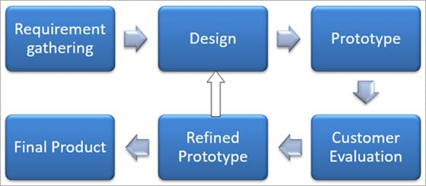
Prototype Model
Advantages of Prototype Model:
Prototype model reduces the cost and time of development as the defects are found much earlier.
Missing feature or functionality or a change in requirement can be identified in the evaluation phase and can be implemented in the refined prototype.
Involvement of a customer from the initial stage reduces any confusion in the requirement or understanding of any functionality.
Disadvantages of Prototype Model:
Since the customer is involved in every phase, the customer can change the requirement of the end product which increases the complexity of the scope and may increase the delivery time of the product.

Slide 57
Spiral Model
The Spiral Model includes iterative and prototype approach.
Spiral model phases are followed in the iterations.
The loops in the model represent the phase of the SDLC process i.e. the innermost loop is of requirement gathering & analysis which follows the Planning, Risk analysis, development, and evaluation.
Next loop is Designing followed by Implementation & then testing.

Slide 58
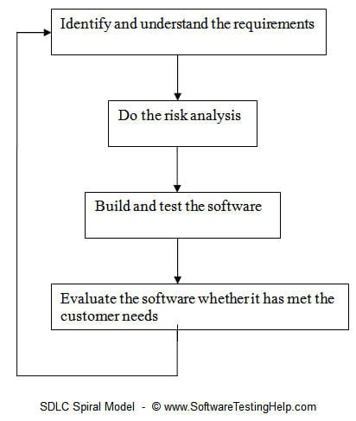
Spiral Model

Slide 59
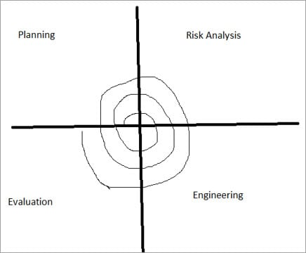
Spiral Model
Spiral Model has four phases:
Planning
Risk Analysis
Engineering
Evaluation

Slide 60
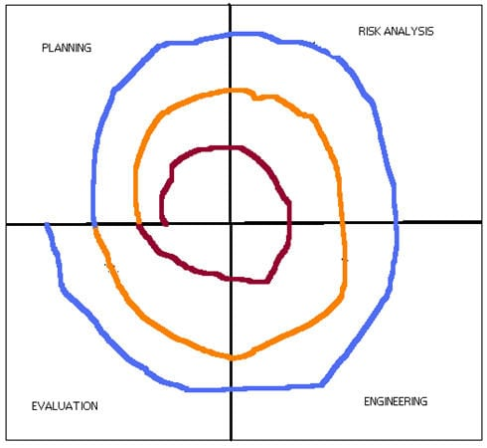
Spiral Model
Different colors represent different spiral or iteration.
For first iteration, represented in brown color, all the 4 activities (Planning, risk analysis, engineering and evaluation) are performed.
After the evaluation phase is over for the first iteration (spiral), second iteration (spiral) starts
The second iteration, which is represented in orange color, here again all the 4 activities (Planning, risk analysis, engineering and evaluation) are performed.
In a similar way, third iteration is done shown in blue color and so on the process continues.

Slide 61
Spiral Model
Phase Name | Activities performed | Deliverables / Output
Planning | Requirements are studied and gathered. Feasibility study Reviews and walkthroughs to streamline the requirements | Requirements understanding document Finalized list of requirements.
Risk Analysis | Requirements are studied and brain storming sessions are done to identify the potential risk Once the risks are identified , risk mitigation strategy is planned and finalized | Document which highlights all the risks and its mitigation plans.
Engineering | Actual development and testing if the software takes place in this phase | Code Test cases and test results Test summary report and defect report.
Evaluation | Customers evaluate the software and provide their feedback and approval | Features implemented document

Slide 62
When to Use Spiral model?
When the project is large.
Where the software needs continuous risk evaluation.
Requirements are a bit complicated and require continuous clarification.
Software requires significant changes.
Where enough time frame is their to get end user feedback.
Where releases are required to be frequent.

Slide 63
Spiral Model
Advantages of Spiral Model:
Development is fast
Larger projects / software are created and handled in a strategic way
Risk evaluation is proper.
Control towards all the phases of development.
More and more features are added in a systematic way.
Software is produced early.
Has room for customer feedback and the changes are implemented faster.
Disadvantages of Spiral Model:
Risk analysis is important phase so requires expert people.
Is not beneficial for smaller projects.
Spiral may go infinitely.
Documentation is more as it has intermediate phases.
It is costly for smaller projects.

Slide 64
Iterative Incremental Model
The iterative incremental model divides the product into small chunks.
For Example, Feature to be developed in the iteration is decided and implemented. Each iteration goes through the phases namely Requirement Analysis, Designing, Coding, and Testing. Detailed planning is not required in iterations.
Once the iteration is completed, a product is verified and is delivered to the customer for their evaluation and feedback. Customer’s feedback is implemented in the next iteration along with the newly added feature.
Hence, the product increments in terms of features and once the iterations are completed the final build holds all the features of the product.

Slide 65
Iterative Incremental Model
Phases of Iterative & Incremental Development Model:
Inception phase
Elaboration Phase
Construction Phase
Transition Phase

Slide 66
Iterative Incremental Model
Advantages of Iterative & Incremental Model:
Any change in the requirement can be easily done and would not cost as there is a scope of incorporating the new requirement in the next iteration.
Risk is analyzed & identified in the iterations.
Defects are detected at an early stage.
As the product is divided into smaller chunks it is easy to manage the product.
Disadvantages of Iterative & Incremental Model:
Complete requirement and understanding of a product are required to break down and build incrementally.

Slide 67
Big Bang Model
Big Bang Model does not have any defined process. Money and efforts are put together as the input and output come as a developed product which might be or might not be the same as what the customer needs.
Big Bang Model does not require much planning and scheduling. The developer does the requirement analysis & coding and develops the product as per his understanding. This model is used for small projects only. There is no testing team and no formal testing is done, and this could be a cause for the failure of the project.

Slide 68
Big Bang Model
Advantages of Big Bang Model:
It’s a very simple Model.
Less Planning and scheduling is required.
The developer has the flexibility to build the software of their own.
Disadvantages of the Big Bang Model:
Big Bang models cannot be used for large, ongoing & complex projects.
High risk and uncertainty.

Slide 69
Agile Model
Agile Model is a combination of the Iterative and incremental model. This model focuses more on flexibility while developing a product rather than on the requirement.
In Agile, a product is broken into small incremental builds. It is not developed as a complete product in one go. Each build increments in terms of features. The next build is built on previous functionality.
In agile iterations are termed as sprints. Each sprint lasts for2-4 weeks. At the end of each sprint, the product owner verifies the product and after his approval, it is delivered to the customer.
Customer feedback is taken for improvement and his suggestions and enhancement are worked on in the next sprint. Testing is done in each sprint to minimize the risk of any failures.

Slide 70
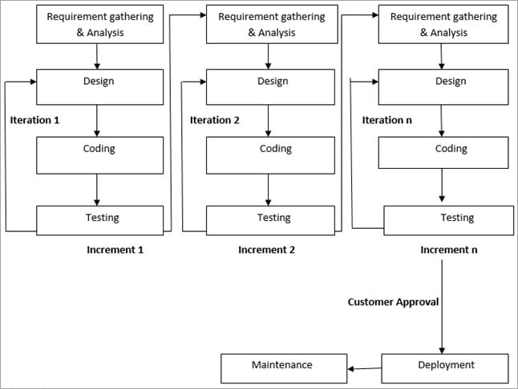
Agile Model

Slide 71
Agile Model
Advantages of Agile Model:
It allows more flexibility to adapt to the changes.
The new feature can be added easily.
Customer satisfaction as the feedback and suggestions are taken at every stage.
Disadvantages:
Lack of documentation.
Agile needs experienced and highly skilled resources.
If a customer is not clear about how exactly they want the product to be, then the project would fail.

Slide 72
Conclusion
Adherence to a suitable life cycle is very important, for the successful completion of the Project. This, in turn, makes the management easier.
Different Software Development Life Cycle models have their own Pros and Cons. The best model for any Project can be determined by the factors like Requirement (whether it is clear or unclear), System Complexity, Size of the Project, Cost, Skill limitation, etc.
Example, in case of an unclear requirement, Spiral and Agile models are best to be used as the required change can be accommodated easily at any stage.
Waterfall model is a basic model and all the other SDLC models are based on that only.

